Slide 1
Lesson objective
Need whiteboards and calculators.
PBiS focus: Empathy – allowing others to work
Title: Isometric drawings
Aim – be able to:
Draw isometric and oblique solids
Compare best buys using unitary method
Plan:
Review best buys
3D drawings

Slide 2
Cost per 100g revision
Chocolate costs $9.50 for 500g. How much is it for 100g?
Cheese costs $11 for 300g. How much is it per 100g?
Cat food costs $42 for 1400g. How much is it for 100g?

Slide 3
Whiteboards
Divide to get 100g cost
Which is better value? Compare 100g prices
Mr. Davies favourite chocolate
Some other chocolate
$8 for 200g.
$18 for 500g

Slide 4

Comparing
Find and write the groups ($$ and Quantity)
$cost ÷quantity$
Answer as a statement per unit
Copy on whiteboards
I do
300g of chocolate for $4.30
550g of chocolate for $6.10

Slide 5
Comparing
Find and write the groups ($$ and Quantity)
$cost ÷quantity$
Answer as a statement per unit
On whiteboards
We do
250g of cheese for $2.30
620g of cheese for $5.15

Slide 6
Comparing
Find and write the groups ($$ and Quantity)
$cost ÷quantity$
Answer as a statement per unit
On whiteboards
you do
310g of vegemite for $5.60
850g of vegemite for $16

Slide 7
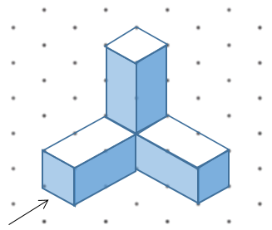
We do - Orthogonal
This view is called….
Use grid side
TOP
FRONT
RIGHT

Slide 8
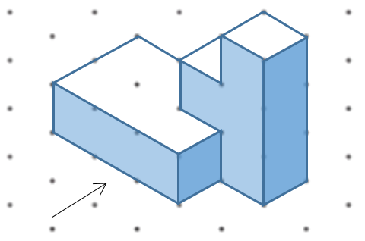
Whiteboards
Use grid side
TOP
FRONT
RIGHT

Slide 9
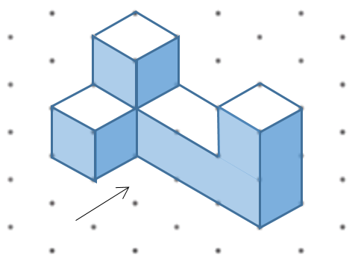
Whiteboards
Use grid side
TOP
FRONT
RIGHT

Slide 10

Iso-met-ric drawings

Slide 11
Oblique drawings
Lines going in the same direction must be parallel.
What does parallel mean?
Lines on a plane that never meet. They are always the same distance apart.

Slide 12
Individual practice
Drawing 3D on 2D pg. 70. (C.F)
Math-o-magic 1.3/1 who always has guests for dinner?

Slide 13
Individual practice
Drawing 3D on 2D pg. 65.
Read through.
Finished early:

